Slide 1
3rd year Subject Choice
2016

Slide 2
CORE SUBJECTS
ENGLISH
IRISH
MATHS

Slide 3
OPTIONAL SUBJECTS – PICK 4
FRENCH GERMAN
CONSTRUCTION STUDIES TECHNOLOGY DCG
BUSINESS ACCOUNTANCY
MUSIC ART
LCVP & ECONOMICS – START 5TH YR

Slide 4
4th yr - FLEXIBILITY
CAN CHANGE WITHIN BAND - QUOTAS IN PRACTICAL SUBJECTS

Slide 5
CONSTRUCTION STUDIES
NOT ENTRY REQUIREMENT
ARCHITECT,ENGINEER,PRODUCT DESIGNER,PROPERTY,SITE FOREMAN,BUILDING
50% THEORY
25% PRACTICAL EXAM
25% PROJECT

Slide 6
TECHNOLOGY
NOT ENTRY REQUIREMENT ( UCC ENG)
VERY USEFUL FOR ENGINEERING,PRODUCT DESIGN,MAUNFACTURING,QUALITY CONTROL,APPRENTICESHIPS,I.T.
THEORY & WORKSHOP PROCESS – 50%
PRACTICAL – 25%
PROJECT - 25%

Slide 7
DESIGN COMMUNICATION GRAPHICS ( D.C.G.)
NOT ENTRY REQUIREMENT
USEFUL FOR ENGINEERING,AIRCRAFT ,CAR ,PRODUCT DESIGN,ARCHITECTURE,APPRENTICESHIPS.
EXAM – 60%
PROJECT (INCLUDING C.A.D.) – 40%

Slide 9
CHEMISTRY
ENTRY REQUIREMENT FOR
UCC MED,DENT,PHARM
DIT DIETICIAN
UCD VETERINARY
DESIRABLE FOR CHEM.ENG,NUTRITION,FOOD SCIENCE
28 EXPERIMENTS- 4 EXAMINED
LAB REPORTS & CALCULATIONS
100% EXAM

Slide 10
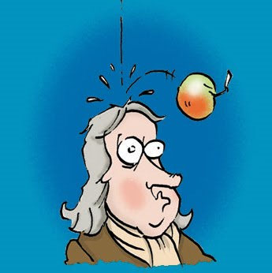
PHYSICS
USEFUL FOR ENGINEERING,GEOLOGY,MEDICAL PHYSICS,
APPRENTICESHIPS (PASS)
WWW.IOP.IE
ENTRY REQUIREMENT FOR THEORETICAL PHYSICS
UCC ENG.AND SCIENCE REQUIRE A SCIENCE SUBJECT

Slide 11
AG SCIENCE
NOT AN ENTRY REQUIREMENT
Useful for agriculture degrees
LOTS OF LEARNING OFF
HARDER THAN BIOLOGY
OVERLAP
b) an assessment of the work of the candidate during the course under the headings: identification of plant and animal types associated with agriculture; practical experience with crops, livestock, house and farmyard layouts; investigations carried out related to ecology, soil science, animal physiology, plant physiology, genetics and microbiology.

Slide 12
Business
Not an Entry requirement
Useful for Commerce,Economics,
Business,Finance degrees , Self employment
100% exam

Slide 13
Accounting
J Cert Business a pre – requisite
Good numerical skills help
Not an entry requirement but desirable for Accounting & Finance
100 % exam

Slide 14
French & German
Speaking 25% 20% Listening 20% 25% Reading Comprehension 30% 40% Writing 25% 15%
Entry requirement for NUI colleges for all courses except
Nursing
Engineering
Science
Computer Science

Slide 15
Art
PORTFOLIO ENTRY REQUIREMENT FOR ART COLLEGE & SOME ARCHITECTURE COURSES
3 PRACTICAL EXAMS(MAY)
ART HISTORY – 37%

Slide 16
MUSIC
Listening Paper Examined in June of 6th year 90 minutes duration Four set works, Irish music and general listening skills.
Composition Paper Examined in June of 6th year 90 minutes duration Melody writing and harmony
Performance Examined in April of 6th year Candidates may perform as a soloist or as part of a group or both.
NOT ENTRY REQUIREMENT BUT AUDITIONS NEEDED FOR MUSIC COURSES
USEFUL FOR COMPOSING,SOUND ENGINEERING,MUSIC TECHNOLOGY

Slide 17
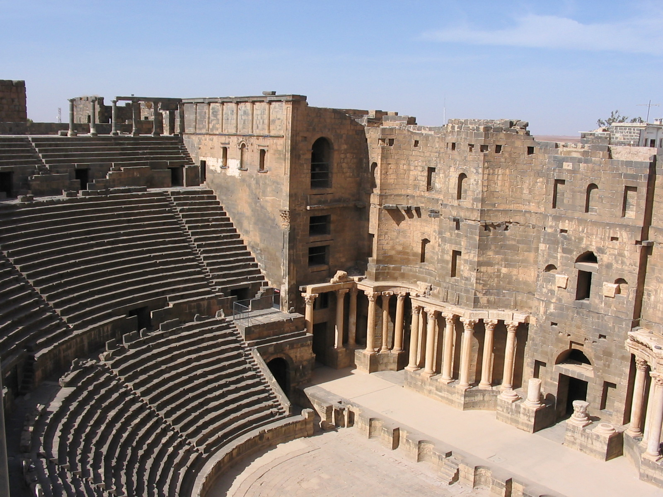
HISTORY
NOT ENTRY REQUIREMENT FOR COLLEGE
USEFUL FOR JOURNALISM,RESEARCHAN TAISCE , EU JOBS
EXAM – 80%
RESEARCH PROJECT – 20%

Slide 18
GEOGRAPHY
NOT ENTRY REQUIREMENT
USEFUL FOR TOWN PLANNING,ENV.SCIENCE,GEOLOGY COURSES
EXAM – 80%
REPORT ON FIELD TRIP – 20%

Slide 19
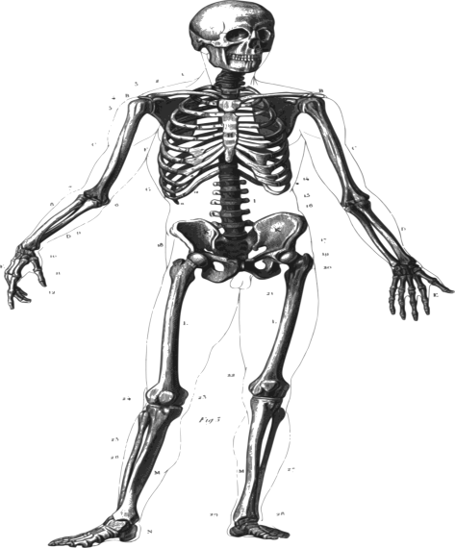
BIOLOGY
NEEDED FOR UCC GENETICS,PRE NURSING,HUMAN HEALTH TCD
SCIENCE & ENGINEERING UCC REQUIRE 1 SCIENCE
UCC MED,DENT,PHARM - 2 SCIENCES
USEFUL FOR HEALTHCARE,RESEARCH, FOOD &PHARMACEUTICAL INDUSTRY
100% EXAM – 22 EXPERIMENTS
44 CHAPTERS!!

